Slide 1
Barishal Engineering College Hall Management System
Developed by Dhrubo

Slide 2
Functionality
Strong Admin Panel
Student’s Details
Automated Payment System*
Automated Invoice Print
Dynamic User Dashboard

Slide 3
Functionality
Real Time Admin Analytics
Frontend Data
Excel Export
Meal Checker dashboard
Daily Expense
User Notification through SMS & Email

Slide 4
Functionality
Public Notice
Stuff Payment + Expense
Forgot Password
Telegram Chat bot*
Two Step Verification
Login Alert & Mail Notification
Daily/Hourly/monthly Backup

Slide 5




Used technology for this project
PHP(Backend)
MySqL(Database)
Javascript(Automation)
Bootstrap(UI)

Slide 6
Demo

Slide 7
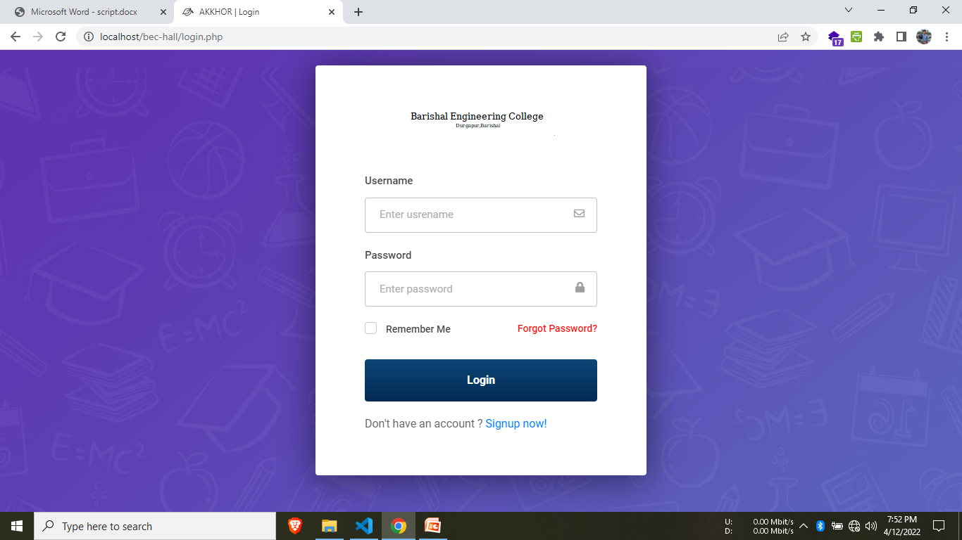
Login Panel

Slide 8
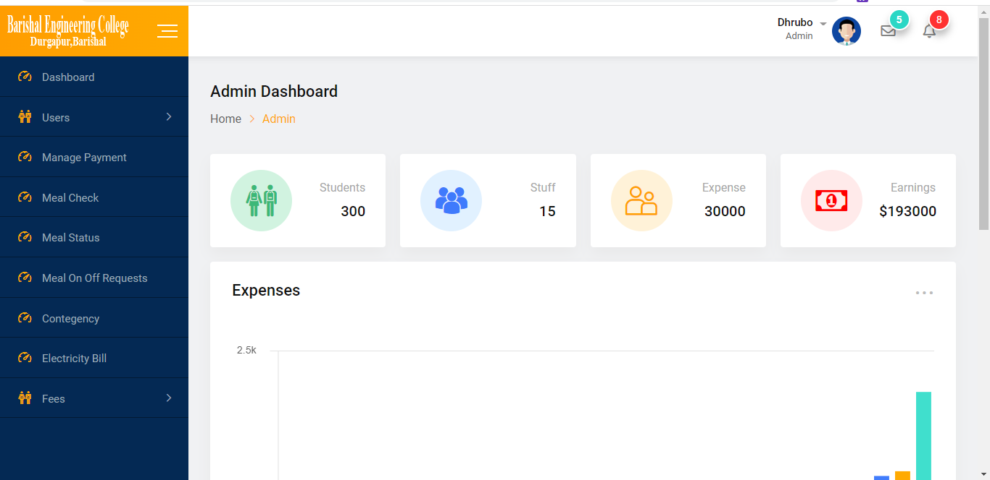
Admin Panel

Slide 9
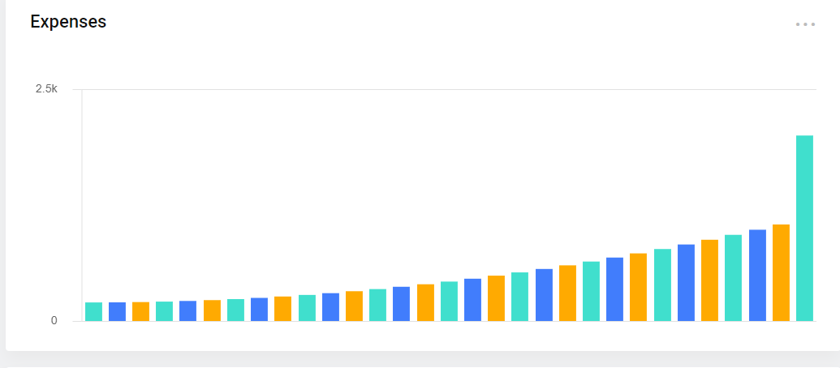
Real Time data analytics
Daily Expance Bar Chart

Slide 10
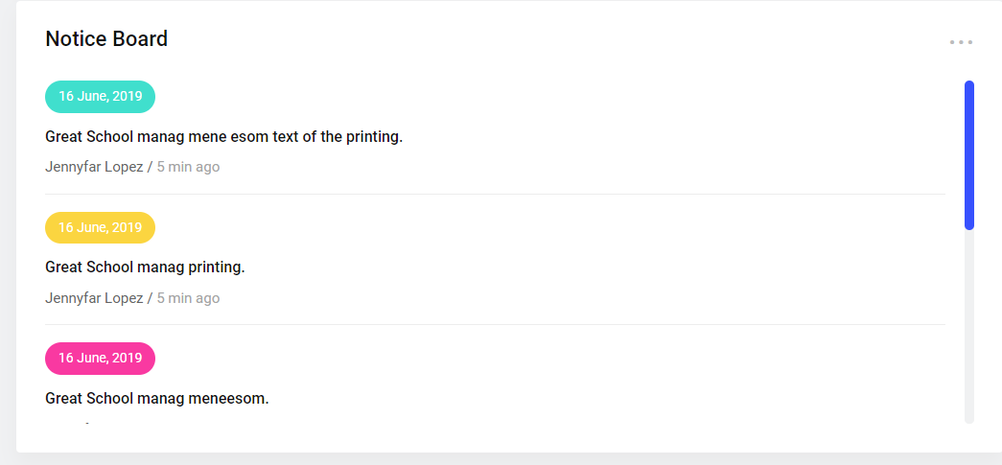
Real Time data analytics
Notice Board

Slide 11
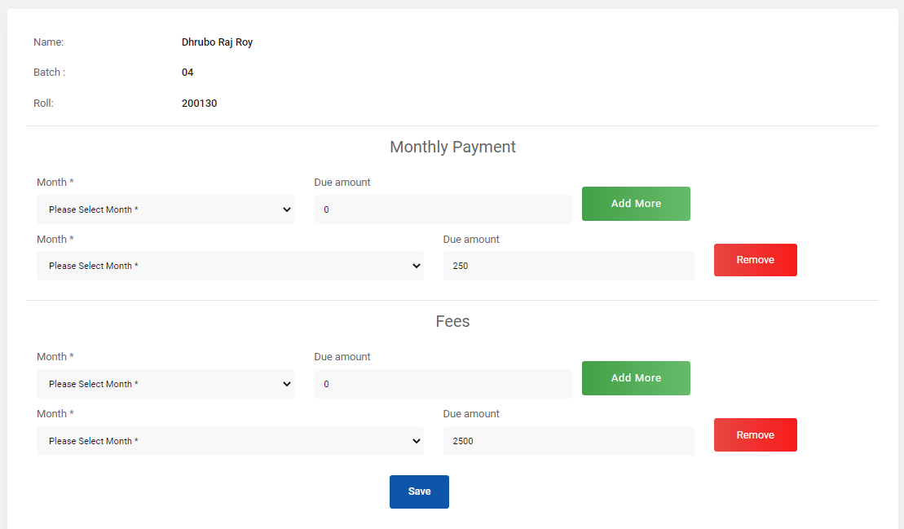
Payment Control Page

Slide 12
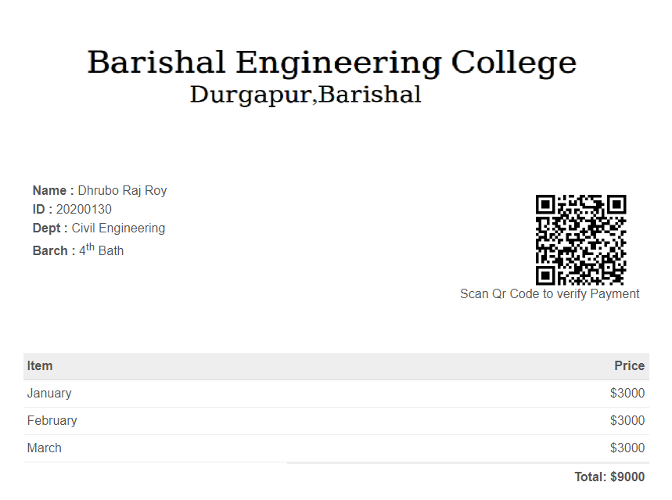
Invoice Page(It will be auto printed And Delivered to the Students)
An Print Page Will be auto popup and ask for confirm Print

Slide 13
QR Code System
Real Invoice

Slide 14
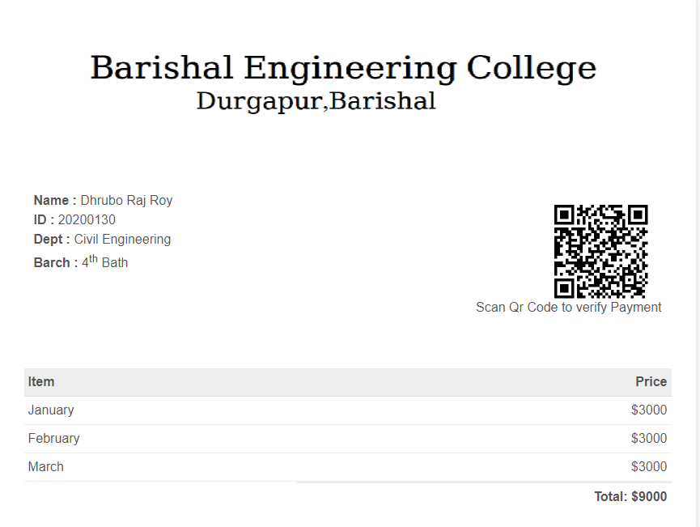
Fake Invoice

Slide 15
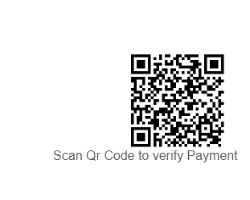
QR Code System
This QR code will be auto generated And Printed to the invoice so that the user can verify the payment

Slide 16
User Dashboard Overview

Slide 17
Login Panel

Slide 18
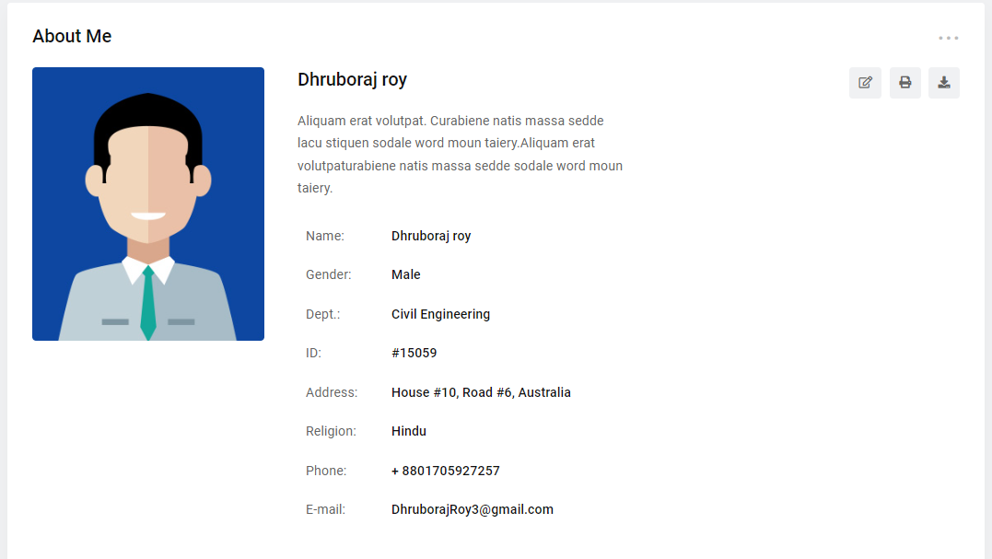
Profile Page

Slide 19
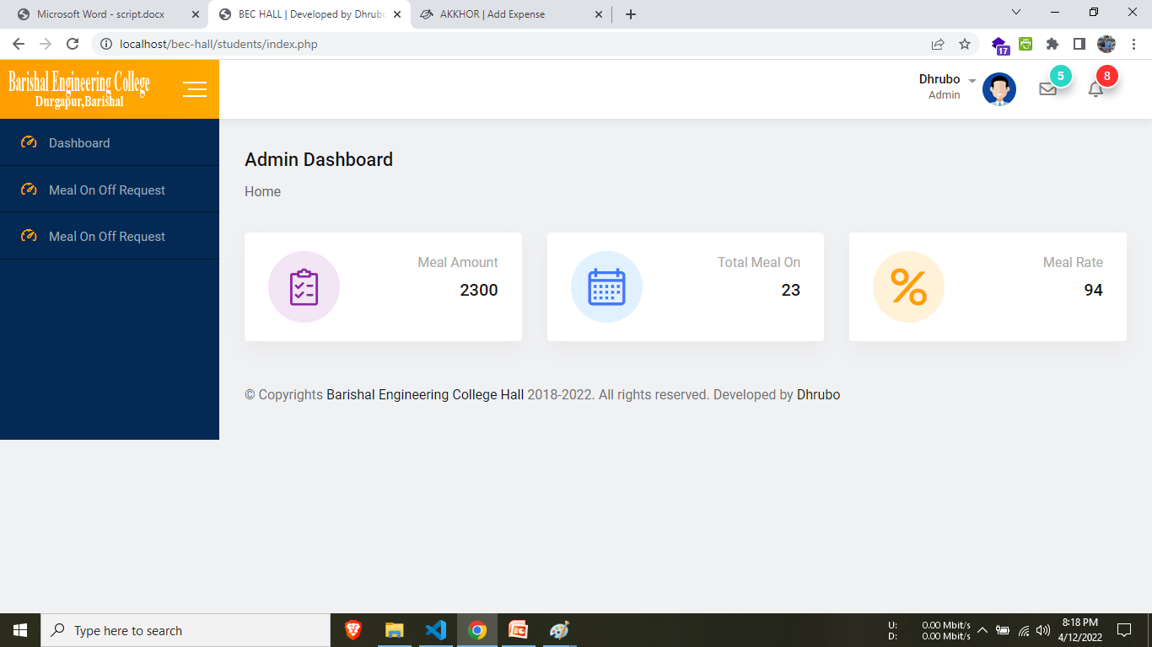
User Analytics
This page will contain The analytics of the user

Slide 20
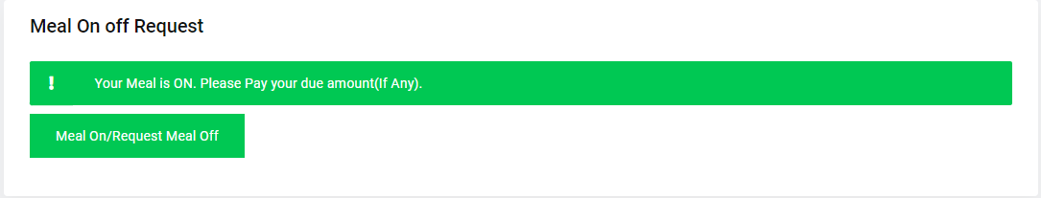
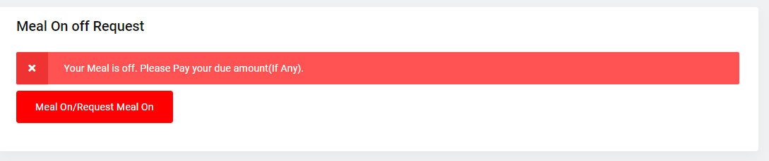
User Analytics
This page will contain The analytics of the user

Slide 21
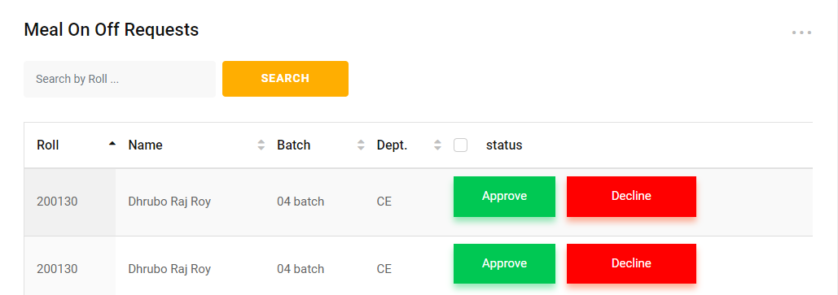
Meal On off Request
This page will show the meal on off requests that are requested by the users(Students).

Slide 22
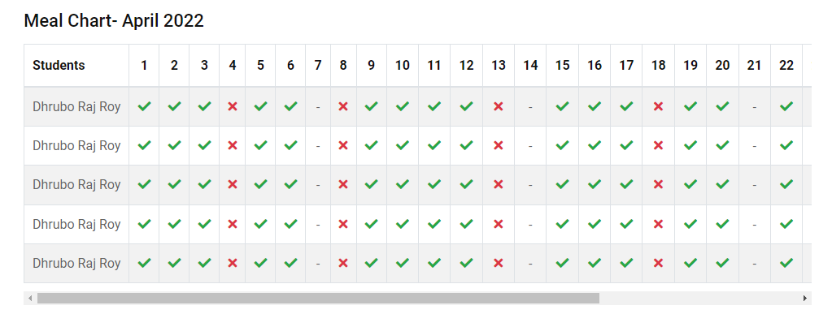
Meal On off Analytics
This page will contain The analytics of all the meal chart

Slide 23
Let’s Dive into the software
Thank You So Much

